Slide 1
OBJECTS & CLASSES
Notes:
Object Oriented Programing… It might sound intimidating… but it is quite easy once you get a hang of it. It will make your projects more dynamic and manageable.
NOTE: change this to enemy

Slide 2
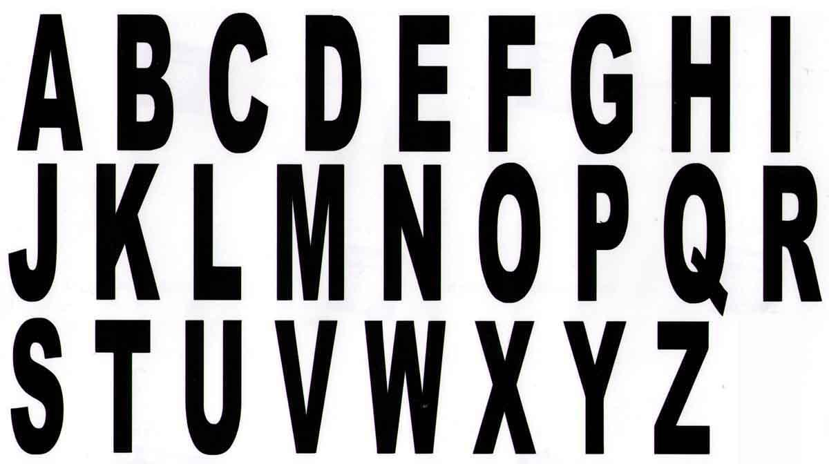
What is a Class? An Object?
Notes:
Objects are a way to group variables and related functions… unlike primitive data types like INT or FLOAT that can only store one variable… objects can store multiple variables and functions.

Slide 3
Why Objects?
Some Familiar Classes
Management
Modularity
Abstraction
Structure
Inheritance
Hierarchy
PImage
PFont
String
Pshape
Notes:
We use objects for the reasons seen on the screen… You might not be aware of this, but you have already been working with objects. Since you have also been working with variables and functions… all we do now is combine these elements into our objects.

Slide 4
The Ball Object
Data
color
size
speedX
speedY
posX
posY
Methods (functions)
Move
Display
Collision
Notes:
So if we take the example of a letter objects… we want to have within it data related to the characteristics of the letter i.e. color, the character, size, position. Additionally we want to include the functions (methods) of the letter i.e. how it moves, forward, backward, collision.
Discuss difference between [class & object] / [function & method]

Slide 5
Non-Object Programming
Object Oriented Programming
Declare > Setup > Draw
float size
float posX
float posY
float hue
size = 20
posX = 50
posY = 60
hue = 240
draw at 50,60
move to 70,90
Declare Object > Initialize Object > Display Object
Notes:
The manner in which you structure your program differs from a primitive setup. With OOP you declare your object, initialize it, then use it. As your data and methods are within your object, you are setting them up within your object declaration and initialization.

Slide 6
The Class
name Your class name/type
data fields Collection of variables
constructor Default setup
methods Functions of a class
Notes:
Before you create an object you must define a class. A class is like the blueprint for your object. So in our case, the class is like the English alphabet (from A to Z). Each letter made from this plan can vary in their data i.e. color, character, size. Technically an object created from a class is called an instance of that class.
On screen you see the elements of a class.

Slide 7
Class Structure
class Name { //class name
float posX; //declare variables
float posY;
Name() { //build constructor
posX = 50;
posY = 60;
}
void move() { //add movement method
posX += 5;
}
void display() { //add display method
ellipse(posX, posY, 5, 5);
}
}
Notes:
Let’s build the Alphabet class called Alpha. Note Alpha is capitalized, this is the convention to differentiate it from variables and functions.
On screen you see the structure of the class.
First we NAME our class... we then place in and declare our VARIABLES. We create our CONSTRUCTOR where we initialize our variables. The constructor is like a default template. It is wise to include a constructor especially if you are not passing arguments to your object. Additionally it prevents your Processing from giving errors & it’s good practice. Finally we add any METHODS we want… note here we have a move and display method. Don’t forget to close our class with a }
If you do wish to pass arguments to your object see Objects EX3. We will go over the example file for clarity.

Slide 8

Cookie Cutter
object
class
object
Notes:
One of the great things about using objects is the ability to create multiple objects from the same class… note that though the objects are of the same class, they can vary in their qualities. In our class our class is Alpha which represents our Alphabets, while an instance of the class (letter) would be our object.

Slide 9
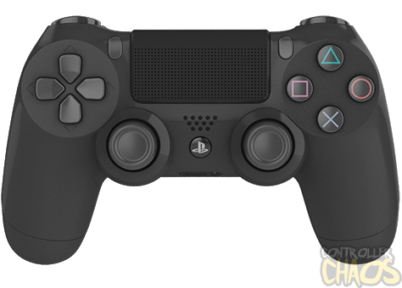
CLASS: (The) DualShock Controller

Slide 10
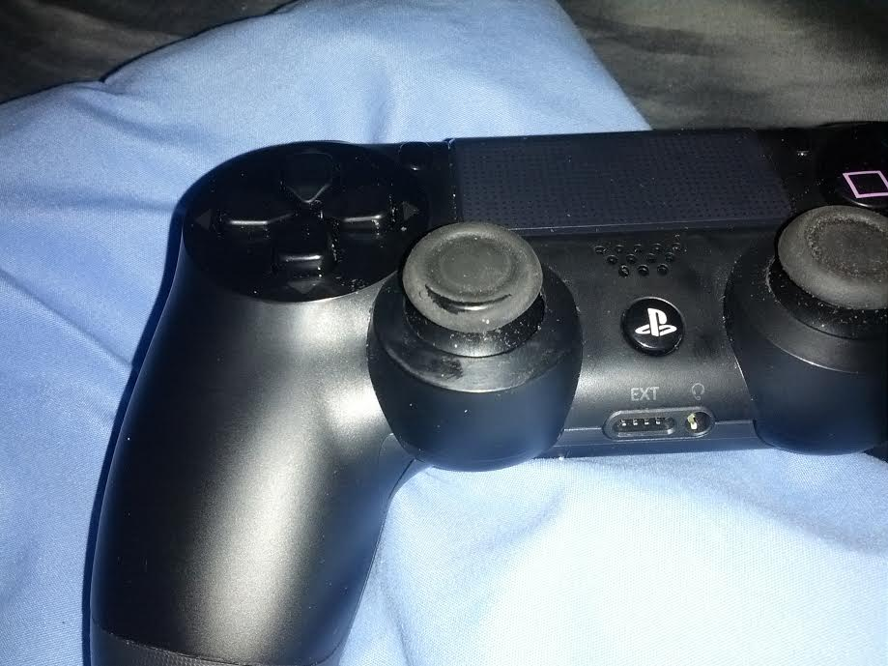
METHOD: Button press

Slide 11
Data Fields / Properties / Variables: boolean xButton;
float leftAnalogXAxis;
float leftAnalogYAxis;
etc.

Slide 12

OBJECT: (a) dualshock controller

Slide 13
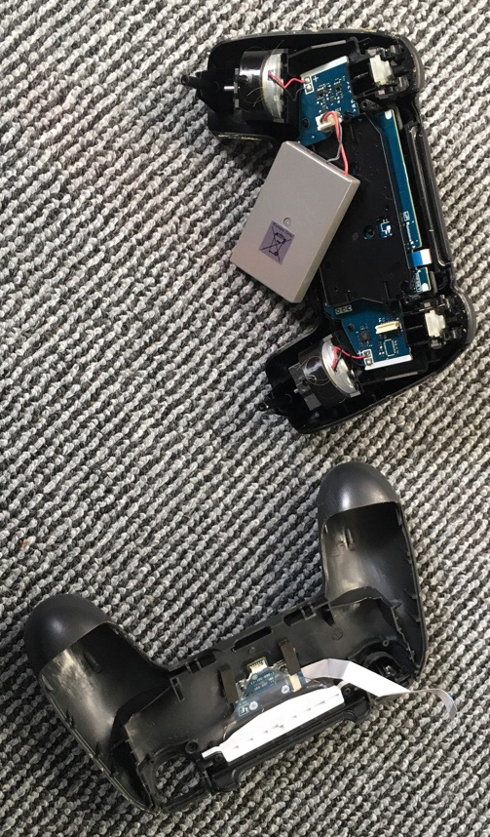

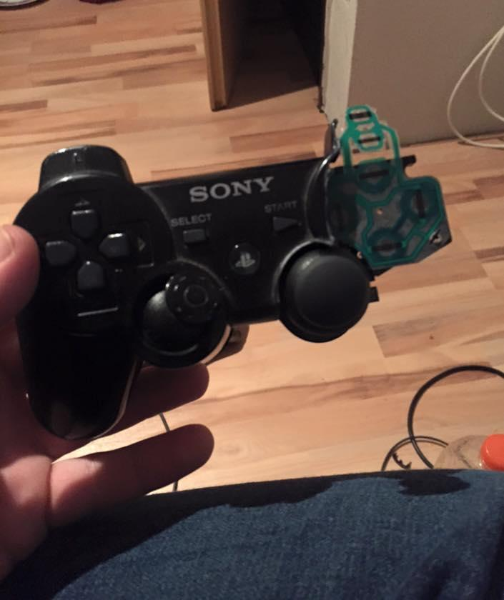
OBJECTS: (these) dualshock controllers

Slide 14
Create Object from Class
Alpha a, b, c, d; //declare object from class Alpha
void setup() { //initialize objects… pass argumt.
a = new Alpha (200, 20, 400, 200, (char) 65, .5, .1, false, .02);
b = new Alpha (200,400, 30, 7, (char) 66, .5, .1, false, .02);
c = new Alpha (90, 77, 90, 67, (char) 67, .5, .1, false, .02);
d = new Alpha (88,56, 300, 150, (char) 68, .5, .1, false, .02);
}
void draw() { //call methods on your object
a.move();
a.collide();
a.display();
}
Notes:
Now we have our class… we wish to make an object from it. How do we do that? Easy… we first DECLARE the objects from the class we wish to use. Then in SETUP we initialize our objects. Finally we call the methods in our class on the object using “.” notation.
Follow along with Objects EX1

Slide 15
Pop Quiz 3
5 minutes

Slide 16
Pop QUIZ 3
A method is an object-oriented programming specific term often used interchangeably with f _ _ _ _ _ _ n?
What is an example of a class in the real world?
What is an example of an object of that same class?
What is an example of a variable of that class?
What is an example of a class built into Processing that we have been used in the past? (e.g., P*****)

Slide 17
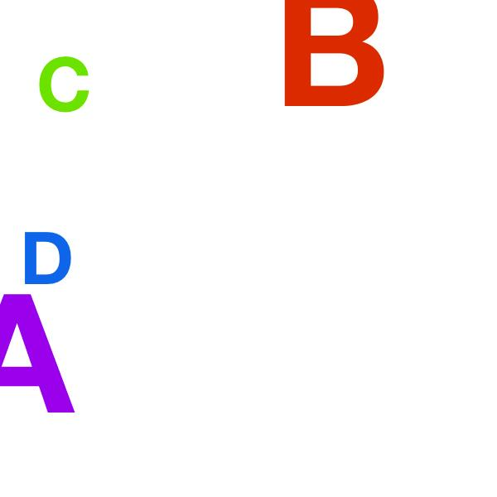
Notes:
WOW… now that’s pathetic. We only have A,B,C,D. What if we want to create a lot of alphabets. It would be tedious to use this method. We need a way to handle multiple objects, to do this we use an array lists. An array list is a dynamic array in which indexed data can be added to or subtracted from with ease. Let’s try it.

Slide 18
ArrayList Example - Constructor
Alpha() {
size = random(30, 80);
posX = random(width);
posY = random(height - 200);
hue = random(255);
//A random uppercase letter from the ASCII table
//See: http://www.asciitable.com/
c = (char) int(random(65, 90));
speedX = 0;
speedY = 0;
isMoving = false;
gravity = 0.2;
}
Notes:
First let’s look at Objects EX4 to see the changes to our CONSTRUCTOR. Here we don’t pass arguments to our object… instead we allow our constructor to do the work by creating random numbers that initialize our variables.

Slide 19
ArrayList Example- Constructor
ArrayList letters;
void setup() {
letters = new ArrayList();
for (int i=0;i<numObj;i++) {
Alpha myletter = new Alpha();
letters.add(myletter);
}
draw() {
for (int i=0;i<numObj;i++) {
Alpha p = (Alpha) letters.get(i);
p.move();
p.collide();
p.display();
}
}
Notes:
Now we define an ArrayList called letters.
Then in our SETUP we create an instance of letter, this is where we will keep the objects created from our class.
Using a for loop we create new instanced of our class called myletter and add them to the array list “letters”.
In our DRAW we call (with a for loop) the object contained in index[i] of the arraylist. We then call the methods move(), collide(), and display() using “.” notation.
Let’s follow in Objects EX4

Slide 20
Beauty of ArrayLists
.add() adds an element to the list
.remove() removes an element from the list
.size() returns length of list
.get() returns element at specified position in list
if (key == 'A' || key =='a') { /// use key A to to arraylist
Alpha myletter = new Alpha();
letters.add(myletter); }
if (key == 'D' || key =='d') {/// use key D to delete from arraylist
if (letters.size()>0){
letters.remove(0); }
}
Notes:
The beauty of arraylists is that it is flexible and variable. Once initialized you can add and remove elements from the list thus changing the size. Regular arrays are incapable of this. Here are some of the methods used in arraylists. In this sketch we use the keyboard inputs A to add elements to the list and D to delete elements from the ist

Slide 21
